Slide 1
ACML101: Introduction to Chemistry
Inorganic Chemistry: Tutorial 2
Coordination Chemistry

Slide 2
(1) Jahn-Teller effect is not observed in high spin octahedral complexes of
(A) d⁷ (B) d8 (C) d⁴ (D) d⁹
The correct option is (B) d⁸
(2) (a)The value of Δo in [Mn(OH₂)₆]³⁺ is 15,800 cm⁻¹ while the mean pairing energy (P) in this complex is 28,000 cm⁻¹. Do you expect this ion to be high or low spin? (b) Determine whether either spin state for this complex is likely to be subject to a Jahn-Teller distortion. If it can occur, which spin state would display the greater effect?
Part a :
when Δo > P, a low spin complex will result and when Δo < P a high spin complex will be observed. Since Δo = 15,800 < P = 28,000 cm-1, a high spin complex will be observed.
Part b: This is a d⁴ ion.
High spin d⁴ should have a strong Jahn-Teller effect as there is a single electron in the degenerate eg level that is oriented directly at the ligands. A Jahn-Teller distortion is also possible for low spin d4 as this places 4 electrons in the t_{2g} set; however, since the t_{2g} set does not point directly at the ligands, the magnitude of the electronic stabilization gained by doing a Jahn-Teller distortion may not be enough to offset unfavourable energy changes associated with longer bond lengths, more steric crowding etc. and the distortion may not actually be observed.

Slide 3
Q3. An aqueous solution of [TiCl₆]³⁻ showed an absorbance maxima at 13000 cm⁻¹ with a broad hump at 12500 cm⁻¹ in the UV-vis spectrum. Explain the origin of these transitions.
d-orbital splitting diagram of the Ti³⁺ complex
e_{g}
d_{x2-y2}
d_{z2}
d_{xy}
Energy
t_{2g}
d_{yz}
c
b
a
d_{xz}
Answer:
Because of the unequal filling of the t_{2g} or e_{g} orbitals (in the case of the excited state), the splitting of d-orbitals occurs, shown in the right panel. Three possible electronic transitions can occur: a, b, and c. Because of the lower energy gap, the transition c falls in the infrared region (near-infrared region: ∼750-2500 nm or 13000-4000 cm⁻¹), and we don’t observe the peak. However, the other two peaks appear in the UV-vis region (200-1100 nm or 50000-9000 cm⁻¹), corresponding to two peaks at 13000 and 12500 cm⁻¹.

Slide 4
(4) The value of 𝝐_{max} in the electronic spectra of [CuCl₄]²⁻ and [Cu(OH₂)₆]²⁺ differ by a factor of about 100. Comment on this observation and state which complex you expect to exhibit the larger value of 𝝐_{max}. (previous year question)
Both the complex contain Cu²⁺ ion and it is d⁹ system.
[CuCl₄]²⁻ results spin-allowed and Laporte allowed d−d transitions.
[Cu(OH₂)₆]²⁺ results spin-allowed and Laporte forbidden d−d transitions.
Unlike the octahedral case, in a tetrahedral complex the metal p orbitals have the same symmetry (t₂) as do the metal d_{xy}, d_{yz}, and d_{zx} orbitals. Because they are of the same symmetry, the t₂ set of d orbitals will be mixed by the crystal field with the metal p orbitals. This in turn means that an e→t₂ transition contains some d−p component and this component is an allowed transition. Evidently, the intensity of the e→t₂ transition is related to the extent of mixing and the extent of mixing assessed, at least qualitatively, from the intensities of bands in the spectra.
Therefore, 𝝐_{max} value for [CuCl₄]²⁻ is much higher compared to [Cu(OH₂)₆]²⁺.

Slide 5
5. Arrange the following species in the order of increasing Jahn Teller distortion in an octahedral environment high-spin cobalt (III) and low-spin Co(II)
Electron arrangements are (a) high spin Co(III) t_{2g}⁴e_{g}² (b) low-spin Co(II) t_{2g}⁶e_{g}¹
Jahn Teller distortion is more significant when the e_{g} level is unsymmetrically occupied than when the t_{2g} level is unsymmetrically occupied.
So the increasing order of Jahn Teller distortion is High spin Co(III)<low-spin Co(II)
6. Which complex is more stable cis[Cu(en)₂2H₂O] or trans[Cu(en)₂2H₂O]
Due to Jahn Teller distortion Trans is more stable

Slide 6
7. Find out the correct spinel structure for FeCr₂O₄ and NiAl₂O₄
Normal spinel: tetrahedral Fe(II) and octahedral 2Cr(III), CFSE = 0.6Δ_{t} + 12Δ₀ + 12Δ₀
Inverse spinel: tetrahedral Cr(III) and octahedral Fe(II) and Cr(III), CFSE = 0.4Δ_{t} + 4Δ₀ + 12Δ₀
Normal spinel is more preferable
NiAl₂O₄ : Inverse spinal as the p-block elements has no CFSE but Ni(II) has will have much CFSE in octahedral environment
8. Why MgAl₂O₄ form normal spinel ?
CFSE value for Mg(II) and Al(III) are zero. Therefore the preference of the metal ions are decided by the electrostatic interactions. Mg(II) will prefer the tetrahedral hole (four coordinated oxygen) and Al(III) prefer octahedral hole (six coordinated oxygen)

Slide 7
9. Solutions of [Cr(OH₂)₆]³⁺ ions are pale blue green but the chromate ion, CrO₄^{2–}, is an intense yellow. Characterize the origins of the transitions and explain the relative intensities.
Green color of the solution of [Cr(OH₂)₆]³⁺ (t_{2g}³e_{g}⁰) appears because of spin-allowed and Laporte forbidden d−d transition. The color intensity of the solution is weak.
CrO₄²⁻ (d⁰) shows intense yellow color because of oxygen-to-chromium(VI) charge-transfer transitions. Such transitions are Laporte ad spin-allowed, thus very intense and exhibits very high molar extinction coefficient values.

Slide 8
10. Following is the electronic absorption spectra of an aqueous solution of CrCl₃·6H₂O (solid line). It has been observed that the spectrum is blue-shifted (towards higher energy) over time upon keeping the solution for hours, as indicated by short dashes and dot-dashes. Explain the observation based on your knowledge about crystal field theory.
e_{g}
e_{g}
Δ_{O}
Δ_{O}
t_{2g}
t_{2g}
Exchange of Cl‒ by H₂O
Increase of Δ_{O} value
Chromium is initially surrounded by four water molecules and two chloride ions, the spectra of the freshly prepared solution are very similar to the more nearly octahedral complexes. From Figure 4 we also see that the spectrum over a period of several hours transforms to one rather similar to that of the [Cr(H₂O)₆]³⁺ indicating that a rather slow aquation reaction has gone almost to completion .

Slide 9
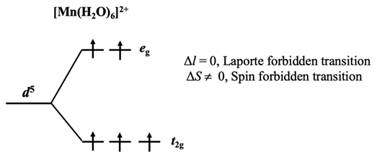
Q11. An aqueous solution of a 0.5 M solution of manganese chloride is very weakly colored, although an aqueous solution of potassium permanganate of same concentration exhibits very intense color. Explain.
Upon dissolving MnCl₂ in water the formation of [Mn^{II}(H₂O)₆]²⁺ occurs. Any d−d transition in this complex is Laporte forbidden (Δl = 0) as well as spin forbidden (ΔS ≠ 0). Therefore, the Mn²⁺ have very low molar extinction coefficient value (ε < 1 M⁻¹ cm⁻¹) and shows very weak color.
On the other hand, the oxidation state of Mn is +VII in KMnO₄, which is a d⁰ system. The intense color of the complex originates from the charge transfer from the filled p-orbitals of oxygen to the empty d-orbitals of Mn^{VII}, which is Laporte-allowed as well as spin-allowed. Therefore, Mn^{VII} has very high molar extinction coefficient value (ε > 10³ M⁻¹ cm⁻¹) and shows a very intense color.
Q12. No d electrons are present in Cr in K₂Cr₂O₇ and K₂CrO₄. However, these two compounds are intensely colored when dissolved in water. Explain.
The color of these compounds appeared because of the charge transfer transition from the oxygen p orbitals to the Cr d orbital, which is Laporte and spin allowed. The molar extinction coefficient of such transition is very high, thus causes intense color.

Slide 10
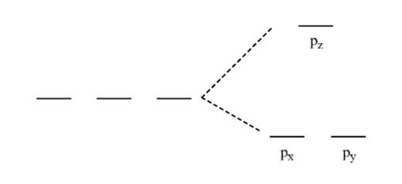
Additional questions which are out of syllabus
Determine how the p orbitals would split in an (a) octahedral and (b) trigonal bipyramidal crystal field.
They would NOT split as all three axes are equivalent in this crystal field
The equatorial trigonal plane is distinct from the axial direction. If the axial direction is taken to be z, then the p_{x} and p_{y} orbitals in the equatorial plane will feel less repulsion because neither of these orbitals points directly at the ligands. In contrast, the p_{z} orbital points along the z axis and right at the ligands so this orbital will be destabilized.

Slide 11
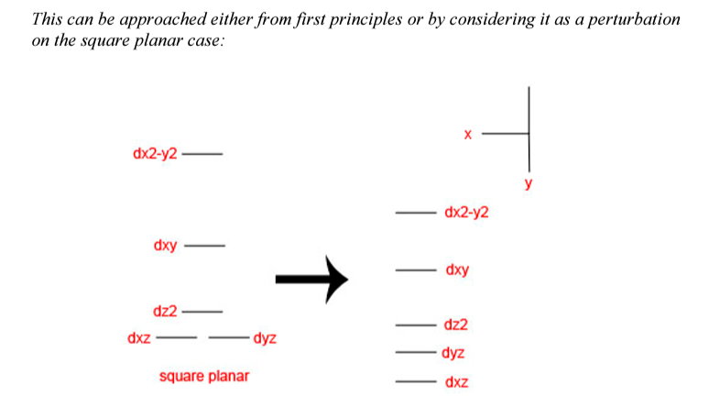
Additional questions which are out of syllabus
Determine the d orbital splitting to be expected (qualitatively) in a T-shaped crystal field (i.e. for a square planar arrangement missing one ligand). Take the complex plane to be the xy plane and make sure you clearly distinguish between the x and y directions. NOTE: represent your answer as a qualitative energy level diagram.

